Slide 1


Introduction to Time Series Analysis
Fondren Library
Digital Scholarship Services

Slide 2
WHAT ARE TIME SERIES?
Simply, data that are collected in a certain order
Evenly or unevenly spaced
Any number of variables

Slide 3
WHAT’S SO SPECIAL ABOUT TIME?
Many statistical models depend upon data points being independent
Linear Regression
Logistic Regression
Many more!
With time series, this basic assumption underlying the entire model can be wrong!
Disastrous results

Slide 4
WHY IS THIS IMPORTANT?
Time series are extremely useful for forecasting
Weather
Stocks (although this is very hard!)
Sports predictions
Election predictions
Well suited to a wide class of problems

Slide 5
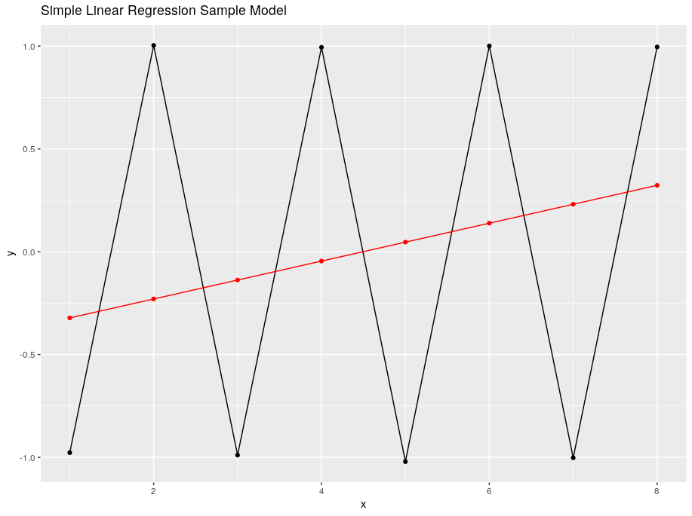
ONE QUICK EXAMPLE
Simple Linear Regression vs. a Time Series Model (ARIMA)

Slide 6
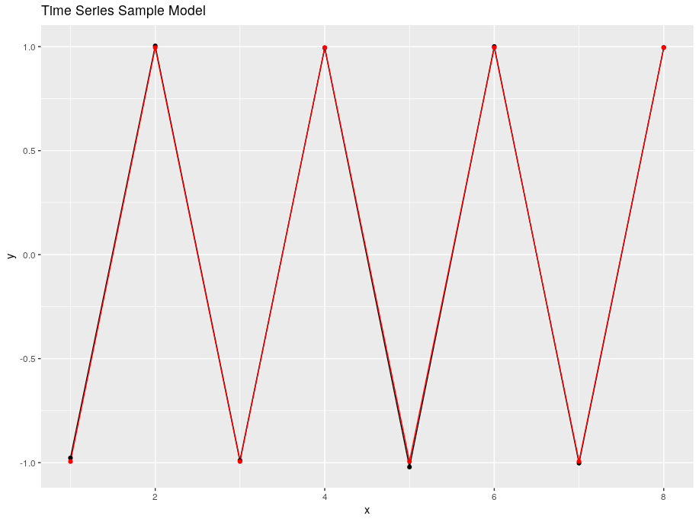
ONE QUICK EXAMPLE
Simple Linear Regression vs. a Time Series Model (ARIMA)

Slide 7
TRENDS AND SEASONALITY
How to filter out the noise and model what really matters

Slide 8
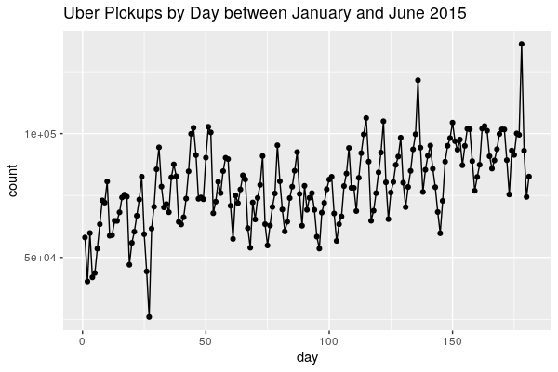
A SAMPLE TIME SERIES

Slide 9
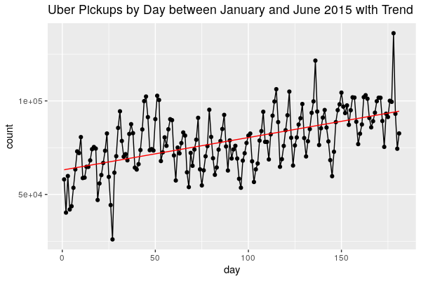
TRENDS

Slide 10
PERIODIC COMPONENTS
Cycles that repeat
Commonly by month, day of week, day of year, etc.

Slide 11
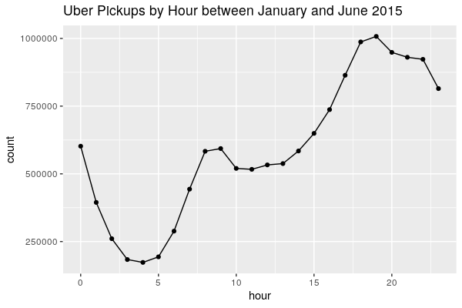
BY HOUR OF DAY

Slide 12
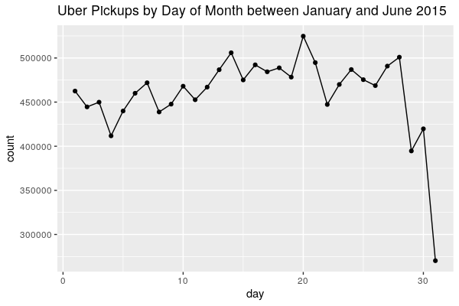
BY DAY OF MONTH

Slide 13
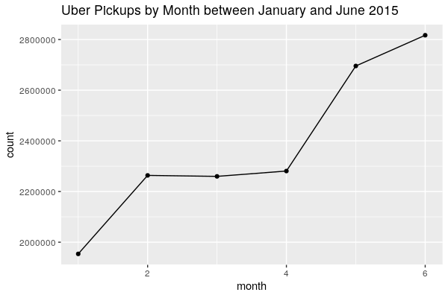
BY MONTH

Slide 14
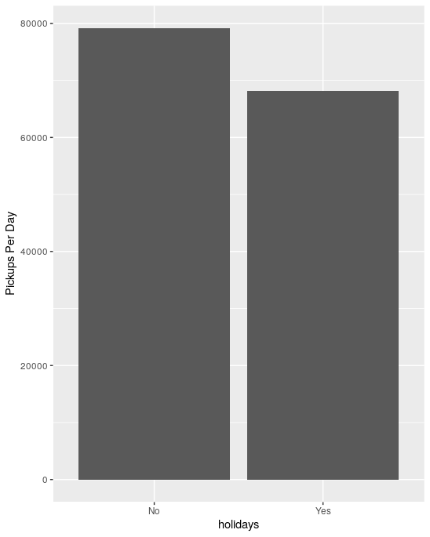
HOLIDAYS

Slide 15
LOOKING BACK AT IT

Slide 16
WHITE NOISE
Not very easy to quantify, but the assumption is that there is some randomness we haven’t accounted for
The statistician’s approach: assume this randomness behaves nicely so we can build some great models!

Slide 17
HOW TO MAKE YOUR DATA STATIONARY
Make your data appetizing for modeling

Slide 18
STATIONARITY

Slide 19
DETRENDING

Slide 20
LAGGING

Slide 21
LAGGED SCATTERPLOTS

Slide 22
ARIMA MODELS
Interpretable, simple and speedy time series modeling

Slide 23
ARIMA

Slide 24
AUTOREGRESSIVE

Slide 25
MOVING AVERAGE

Slide 26
PLAYING AROUND WITH ARIMA

Slide 27
ACKNOWLEDGMENTS

